Slide 1
Hands-on Workshop – Project lead
F-klubben
Netcompany
25-03-2019
1.0
Søren Bonderup
sbon@netcompany.com

Slide 2
Case
Case: Letter distributor
Your customer name, hereafter mentioned as “your customer”.
________________________________________________________
Case description
Your customer has over 10 years of experience with helping civilians sending their letters. Their main clientele is elderly, who for some reason are not able to send letters by themselves.
Since the new invention of digital letters has emerged, it should be possible for a case worker to help citizens send a PDF letter to the common letter distribution service.
Your customer has already started developing on a WPF client using their own internal resources. It was however quickly obvious for them, that they were not able to implement this functionality on their own.
Your customer has asked Netcompany to deliver a system that can send information to the common letter distribution service, filling out much of the information needed on physical mail.
The common letter distribution service – DistriTotal, is undergoing a major change to their API. For that reason they are asking all of their major API-users (existing and upcoming), to come up with a suggestion for the definition of this API. When you have agreed, you will present this to DistriTotal, who will give their perspective.

Slide 3
My workday yesterday
7:30 – Opened the PC
7:32 – 7:47 Windows updates…
7:50 – 9:00 Follow-up on status-updates
9:00 – 9:15 Daily Standup
9:15 – 9:30 Pre prep meeting
9:30 – 9:45 Prep meeting
9:45 – 10:20 Customer meeting
10:20 – 11:00 Eval. customer meeting
11:00 – 11:30 Follow-up on emails
11:30 – 12:04 Lunch
12:04 – 12:15 Meeting
12:15 – 12:45 Follow-up on more emails
12:45 – 13:40 Management status meeting
13:35 – 13:45 Cake and coffee time
13:45 – 14:15 Forgot about the cake and coffee time
14:15 – 15:00 Integration meeting
15:00 – 15:30 Last email follow-up

Slide 4
Task
Collect status from team (emails)
Write the current status of the project to the customers project manager
Consider the following:
Are we still on time and budget?
Are there any errors and if yes how to mitigate?
Are there any opens issues?
Are there any risks?

Slide 5
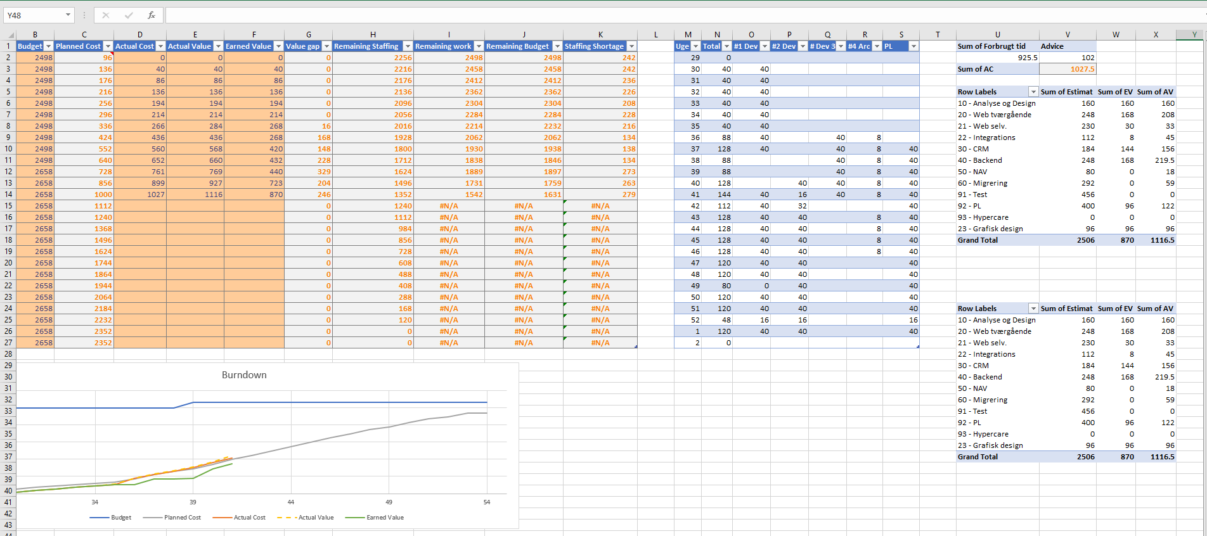
Status

Slide 6
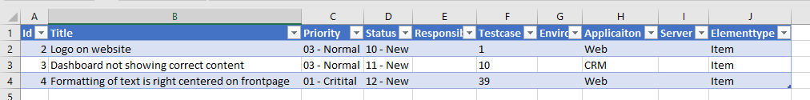
Bugs

Slide 7
Issues

Slide 8
Status from team
Developer 1
Overall summary
We have gotten a nice start on the project but there is still many uncertainties around the requirements for the letter-distributor.
Summary of progress since last week
I am done with stripping the letter-distributor solution for features which are not needed by the client as for now.
Focus next week
Integration to letter-distributor service
Documentation of the letter-distributor client
Risks (if any)
That the letter-distributor have been stripped for too many features and we will end up having to reimplement some of the stripped features.

Slide 9
Status from team
Developer 2
Overall summary We have gotten a nice start on the project but there is still many uncertainties around the requirements for the letter-distributor.
Summary of progress since last week
A lot of coordination with the team which owns the original letter-distributor. We had some good knowledge sharing sessions about the functionality of LD which is going to accelerate the work that will happen in the future
Focus next week
Keep in touch with the owner of the original letter-distributor team.
Start implementing features on the letter-distributor client
Risks (if any) We might run into problems when we go into production as we do not have that any test cases.

Slide 10
Status from team
Developer 3
Overall summary
Great to start on a new project where we are starting with a fork of a very successful NC project!
Summary of progress since last week
A lot of knowledge have been gained from the original owners/team of the letter-distributor and after stripping down the letter-distributor to the need of the client I am quire happy about the plan as is for now. I am pretty sure that we in a mouth or two will be in a very good place.
Focus next week
Assist the Architect with new features from the client, gotten from starting meetings
Improve upon the branch and Git strategy
Risks (if any)
Nope

Slide 11
Status from team
Architect
Overall summary
Everything have started up nicely, and I am pretty confident in the plan even though we are still in the beginning of the project.
Summary of progress since last week
We have finally got the letter-distributor stripped from features which are not needed by the client.
Focus next week
Workshop with client about future requirements
Coordination about the integration
Risks (if any)
A lot need to be clarified with the other team about the integration.

Slide 12
References
Quick intro to Earned Value Management and Burndown charts
https://bit.ly/2FKj9AN
Use template from USB on statusreporting

